Slide 1
Explore Mumbai

Slide 2
Contents
1) Business Problem
2) Data Required
3) Used Algorithm
4) Results
5) Conclusion

Slide 3
1) Business Problem
The exploration of the neighbourhoods of Mumbai will help people to make their best decisions.
This capstone mainly concentrates on exploring the neighbourhoods in Mumbai.
Mumbai is one of the developed cities of India.

Slide 4
Data Required
The data used in this project is as follows:
1) Neighbourhood Data of Mumbai
2) Venues Data from Foursquare

Slide 5
3) K_ Means Clustering
K-means clustering is a type of unsupervised learning, which is used when you have unlabelled data (i.e., data without defined categories or groups).
The goal of this algorithm is to find groups in the data, with the number of groups represented by the variable K.
Labels for the training data (each data point is assigned to a single cluster)

Slide 6
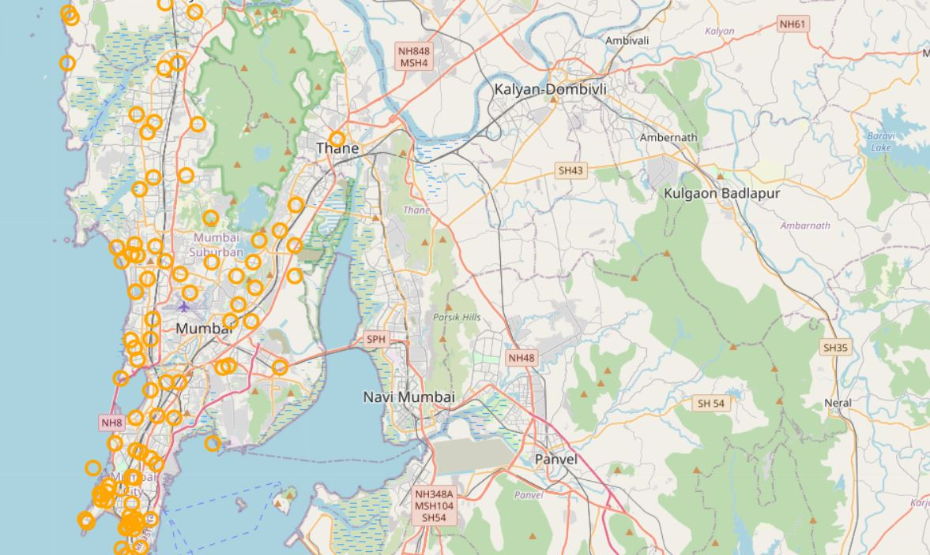
Map of All Restaurants

Slide 7
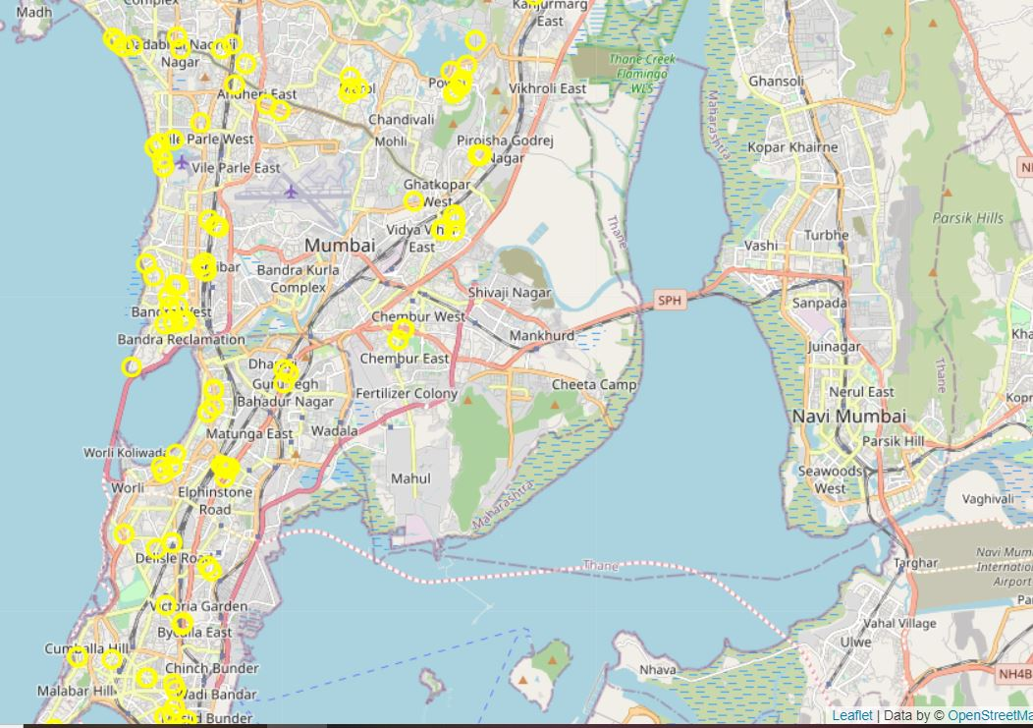
Map of Indian and Asian Restaurants

Slide 8
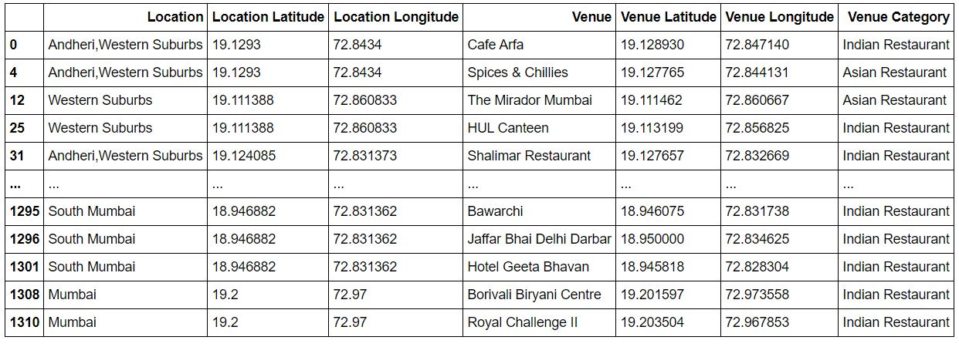
Location wise Restaurants

Slide 9
Conclusion
We have analysed all the Indian and Asian Restaurants present in the neighbourhoods in Mumbai. Every person who likes Indian food can view the survey and take necessary decisions.

Slide 10


